Slide 1

Full Stack Development - MERN Stack
Introduction to FSD & IDE Setting
Presenting By:
G. Venkata Deepthi
(Full stack Mentor)

Slide 2
Agenda
Introduction to full stack development
Web application architecture
What is MERN?
Route Map of MERN stack Development
IDE and its Uses
Downloading of VS code
Set Up of Visual Studio Code
Conclusion

Slide 3



Introduction to full stack development
Process of developing both front end and back end is full stack development.
Back-end
Front-end
Data- base
Data-base

Slide 4
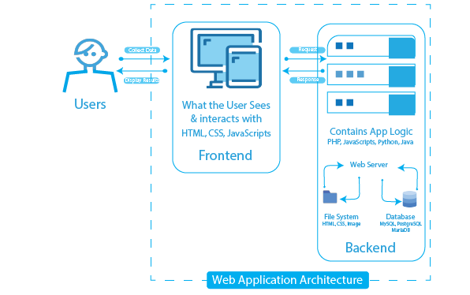
Web application architecture

Slide 5
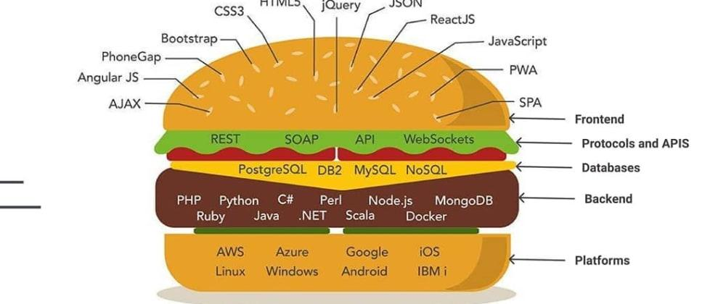

Slide 6
Web Development
Web Development
Front-End
HTML
CSS
Back-End
Node JS
Data-base
JavaScript
Express JS
Mongo-DB
MySQL

Slide 7
What is MERN?
MERN
Mongo-DB
Express JS
React
Node JS

Slide 8
Route Map of MERN Stack

Slide 9
Step-5
Step-6
Node JS , Express JS
Programming Server
SQL , Mongo DB
Data Manipulation
Step-4
Java Script
Interactive Elements
React
Step-3
HTML
Basic Text
and shape
CSS
Style HTML page,
Bootstrap
Step2
Step-1

Slide 10
IDE and its Uses
IDE → Integrated Development Environment
It is designed to provide facilities a programmer needs for software development
It provides text editor , debugger , compiler in one application.
Example → VS code, Eclipse, Net beans, Komodo etc…

Slide 11
Advantages of IDE
Look and feel Customization such as themes, fonts, color.
Auto compiles and runs code
Folder Structure for the project
Provide Syntax highlighting
Automatic indentation for code blocks
Line numbers
Auto code completion
Auto code for inherited members
Provide debugging functionality, identifying syntax and obvious errors
Often provide GUI builders(Drag drop systems) for increased speed
Plug ins for additional functionality + more

Slide 12
Downloading of VS code
Go to browser → type download VS code
Click on very first link https://code.visualstudio.com/download
Run the .exe file

Slide 13
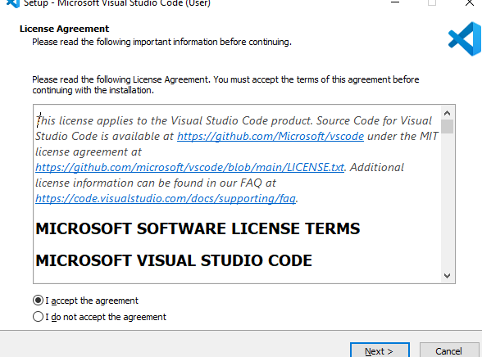
Downloading of VS code
Click next

Slide 14
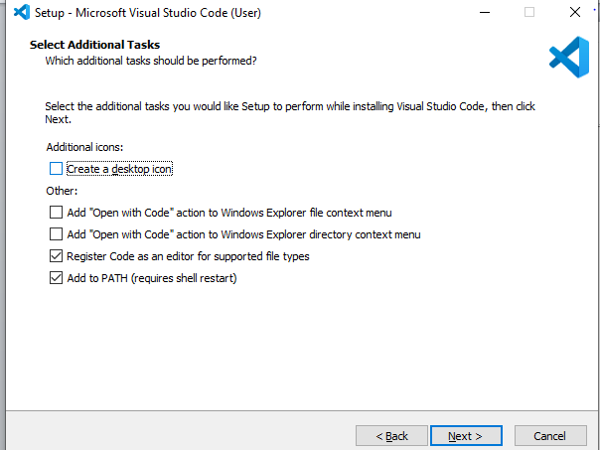
Downloading of VS code

Slide 15
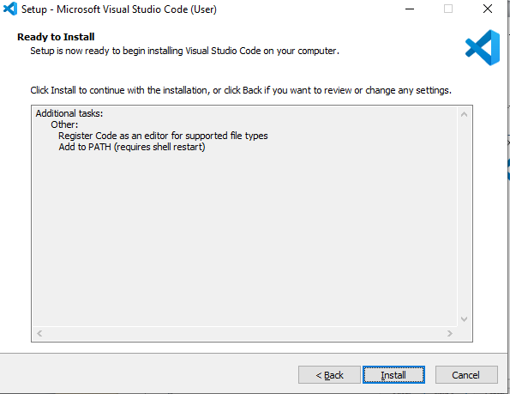
Downloading of VS code

Slide 16
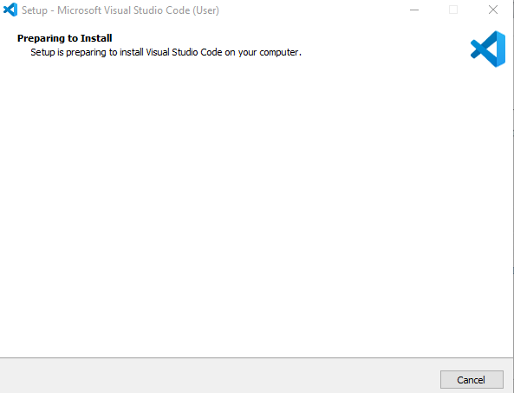
Downloading of VS code

Slide 17
Set up and Extensions of VS code
Extensions → Used to highlight text , auto complete, auto correct
Prettier
Live server
Auto rename tag
CSS peek

Slide 18
Conclusion
With the MERN stack you can ideally build any web application you want by learning just one language, Javascript . With increased popularity of NoSQL databases, MongoDB is a go to database because of its scalability and flexible document schemas.

Slide 19
Questions?

Slide 20
Thank you

